Slide 1
Tools to Support Lasting Change

Slide 2
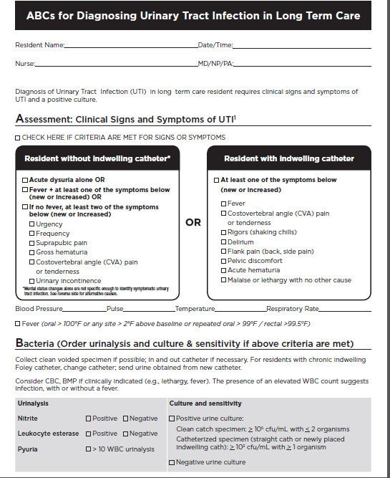
ABCs for diagnosing UTI in long term care
Evidence based guidance for urine testing in the elderly
Research conducted in long term care, but applicable to other settings

Slide 3
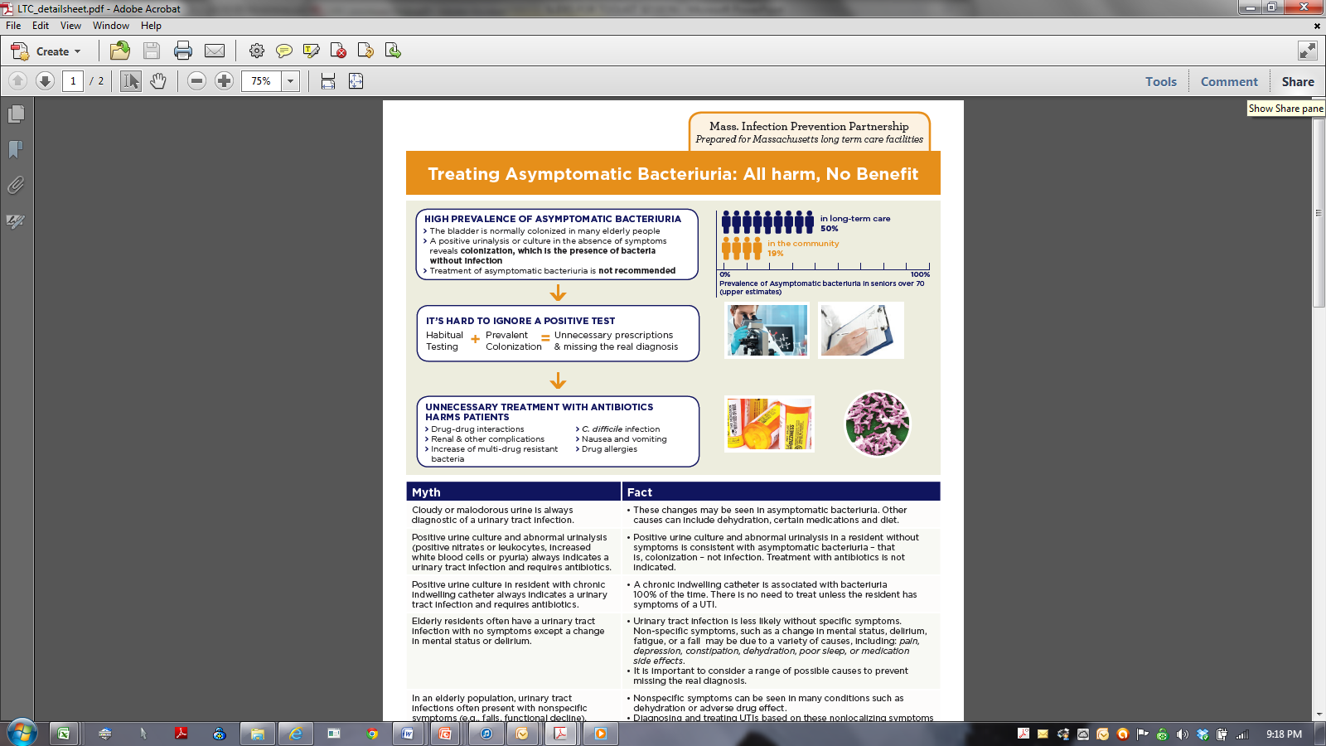
Clinician Education Sheet
Support tool for clinician education
Additional tool available for acute care emergency departments
Revision underway for LTAC and and non-ED hospital units

Slide 4
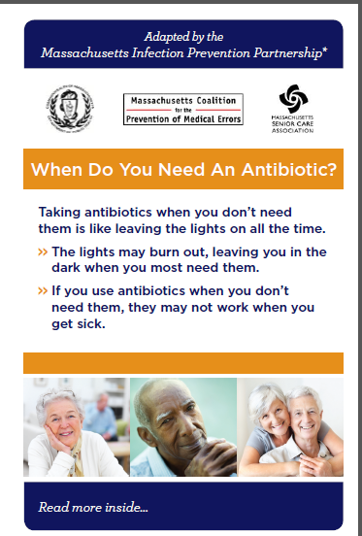
When do you need an antibiotic?
To educate residents and families about the importance of prudent use of antibiotics
Additional brochure available developed for emergency departments
If interest, will adapt for LTAC and non-ED hospital units

Slide 5
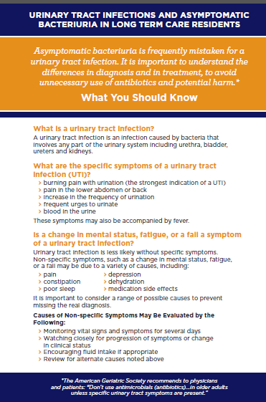
UTI & ASB in Long Term Care Residents
2 sided, print 2 per page
Addresses specific issues around UTI and ASB in the elderly
If interest, will adapt for LTAC and non-ED hospital units

Slide 6
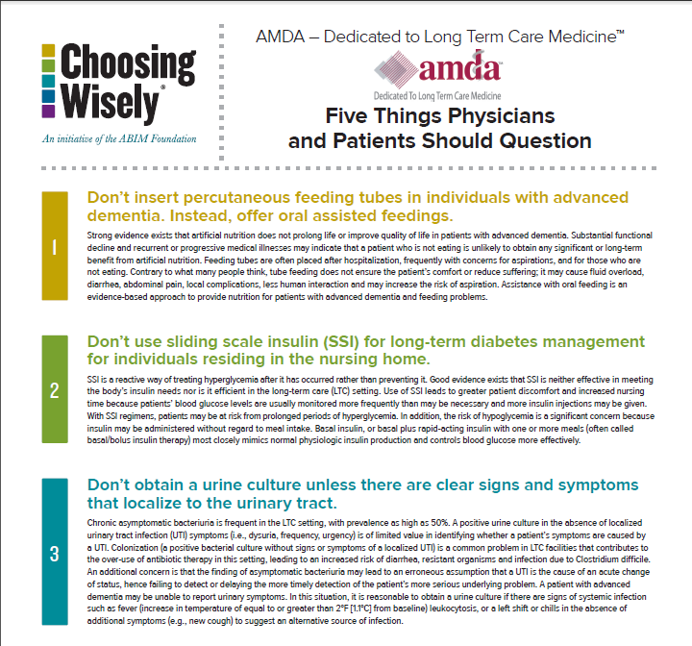

Slide 7
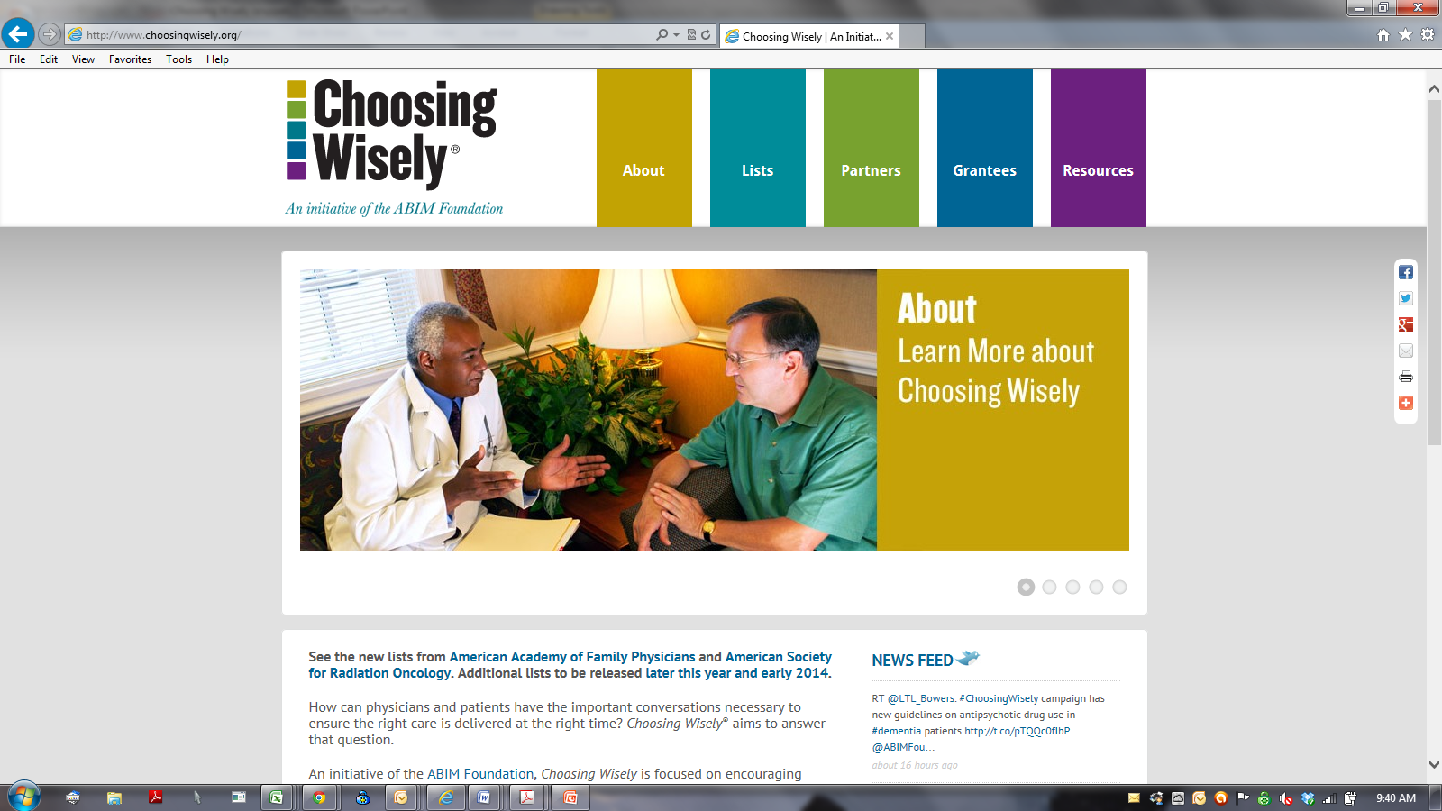
An initiative of the ABIM Foundation, Choosing Wisely is focused on encouraging physicians, patients and other health care stakeholders to think and talk about medical tests and procedures that may be unnecessary, and in some instances can cause harm.
To spark these conversations, leading specialty societies have created lists of “Things Physicians and Patients Should Question” — evidence-based recommendations that should be discussed to help make wise decisions about the most appropriate care based on a patients’ individual situation.
More than 50 specialty societies have now joined the campaign, and 30+ societies will announce new lists in late 2013 and early 2014.

Slide 8
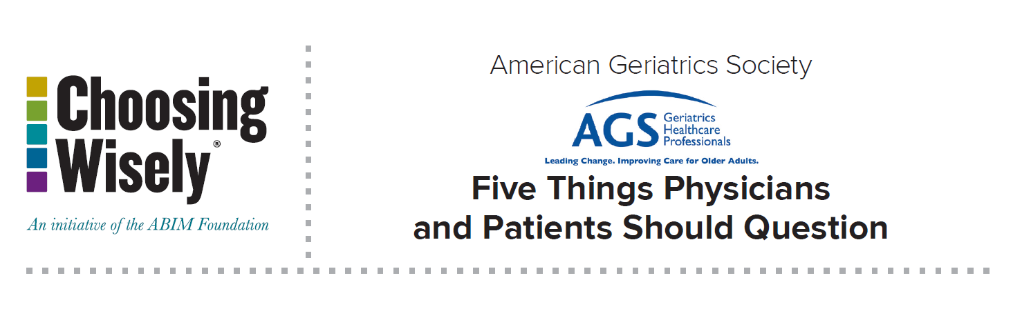
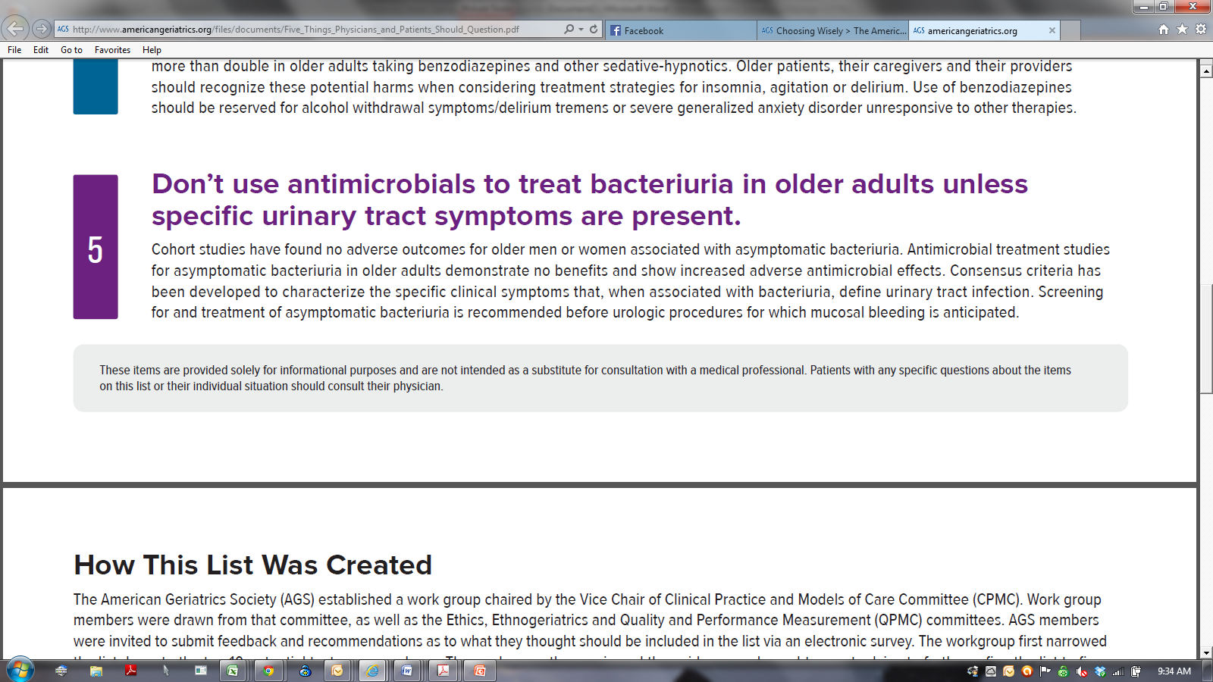
http://www.americangeriatrics.org/files/documents/Five_Things_Physicians_and_Patients_Should_Question.pdf

Slide 9
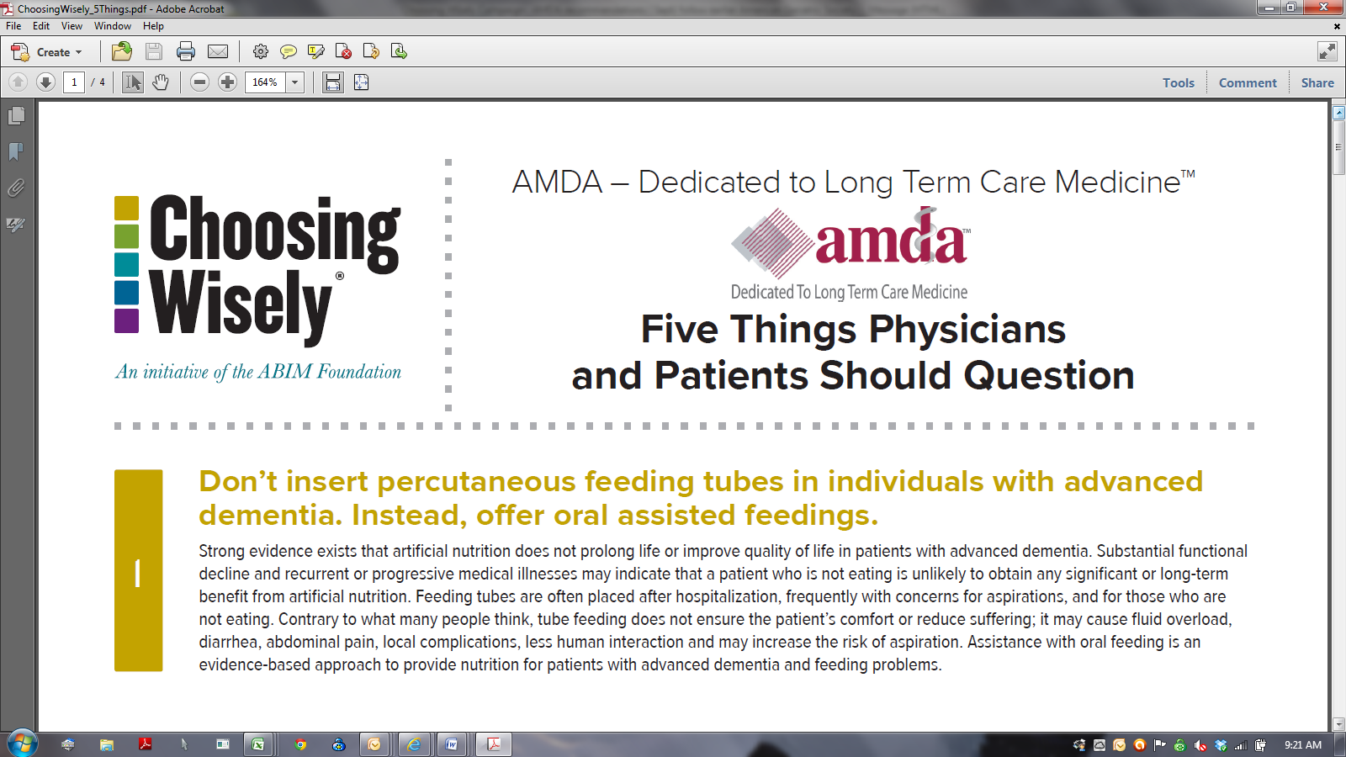
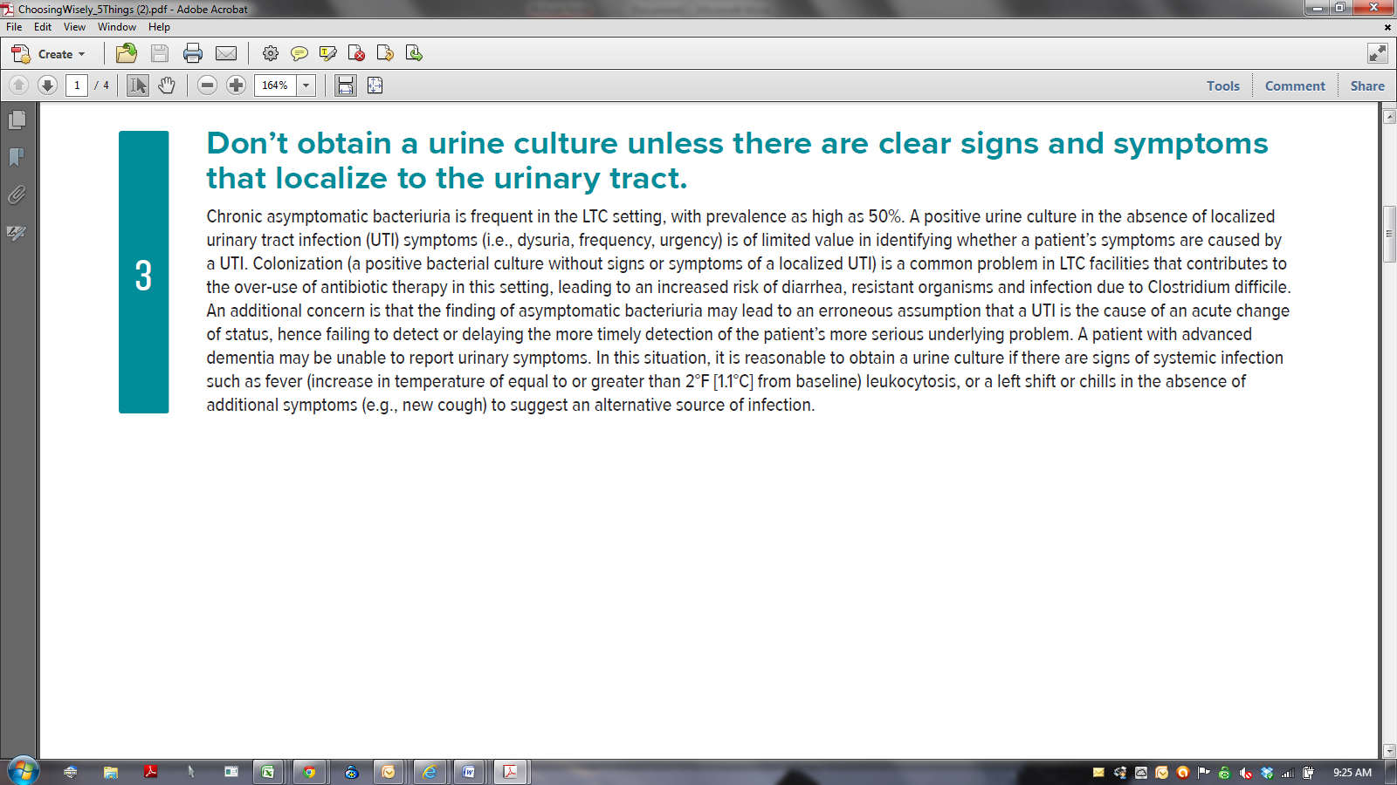
https://www.amda.com/tools/ChoosingWisely_5Things.pdf

Slide 10

Tools that you may already be using that compliment these tools…

Slide 11
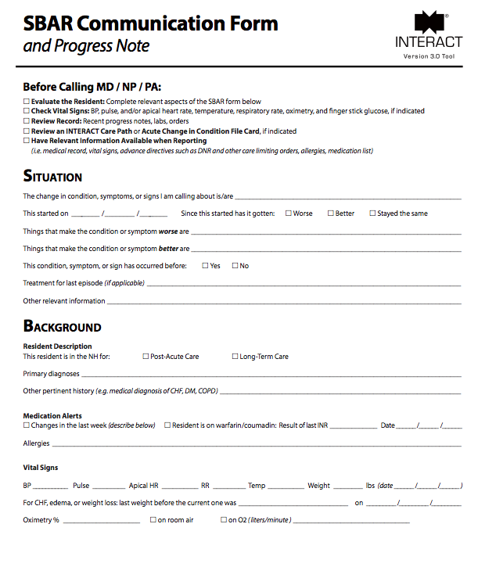
Connecting UTI evaluation to the bigger picture

Slide 12
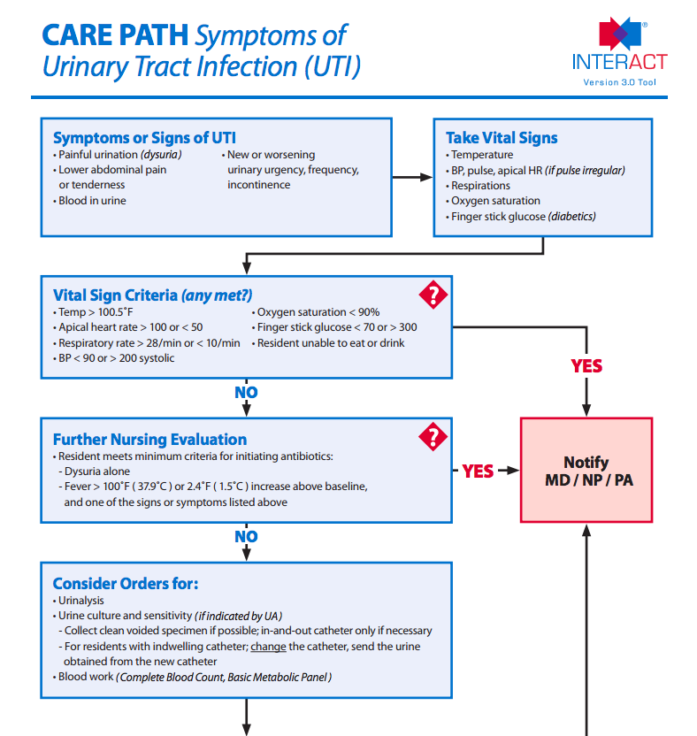
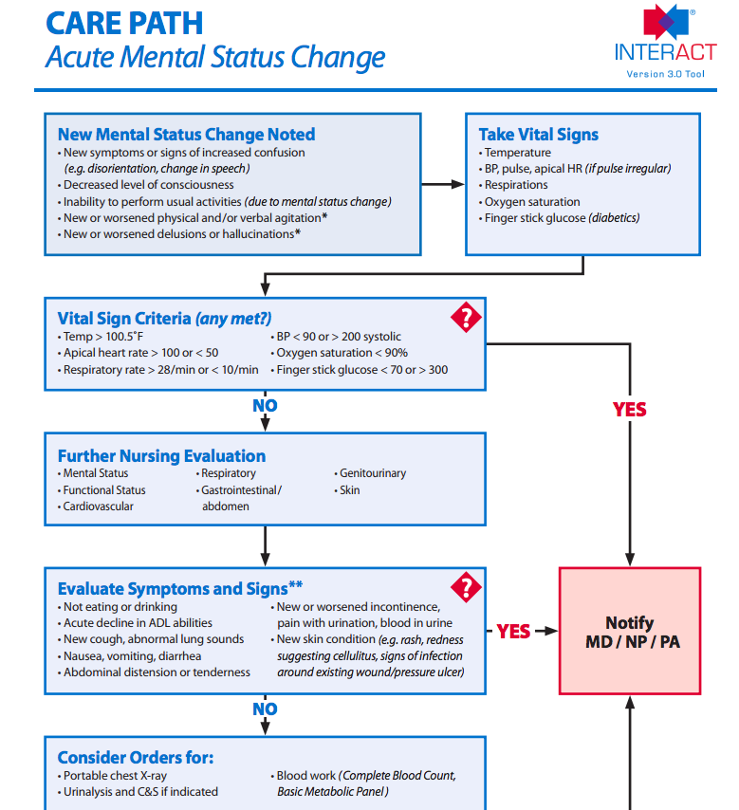
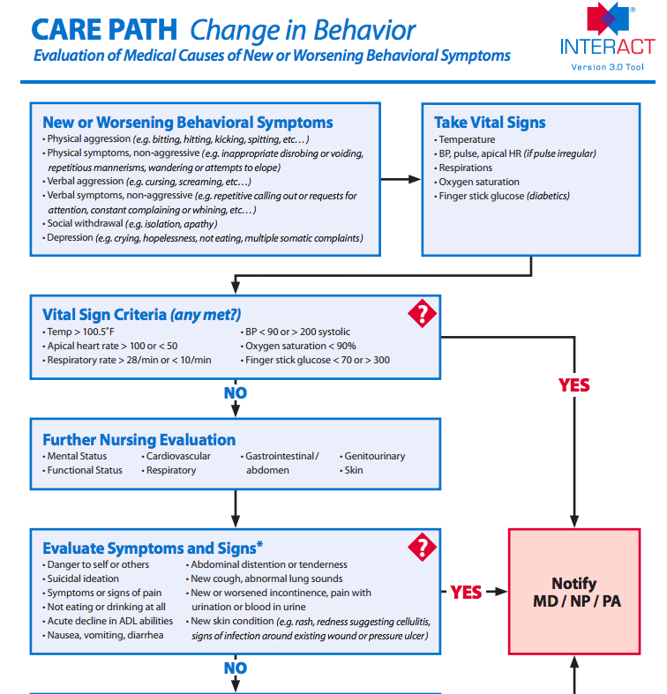

Slide 13

Bottom Line

